Slide 1
Welcome to CS10 Group Ninth Meeting
Team member
Wilma Liu (Leader)
Fiona Hu
Pat Zhang
Elvia Tong
Reehaa Ding
William Quan

Slide 2
This week meeting schedule
Detailed progress report before W7
Detailed progress report after W7
Detailed progress report for travelling problem
Detailed progress report for forecast model improvement
Detailed progress report for business support success measurement

Slide 3
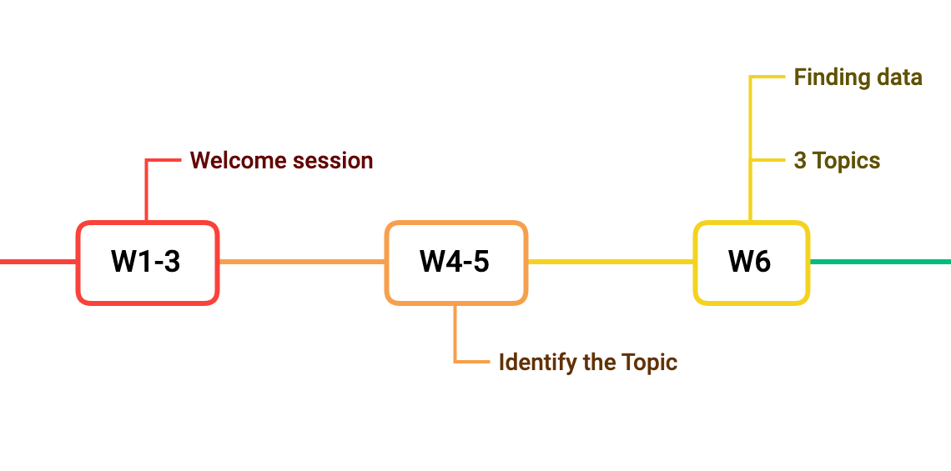
The project timeline

Slide 4
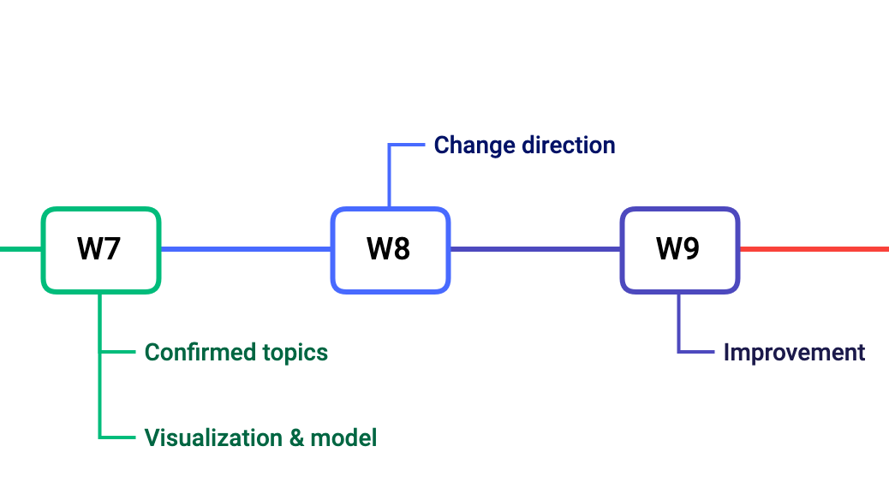
The project timeline

Slide 5
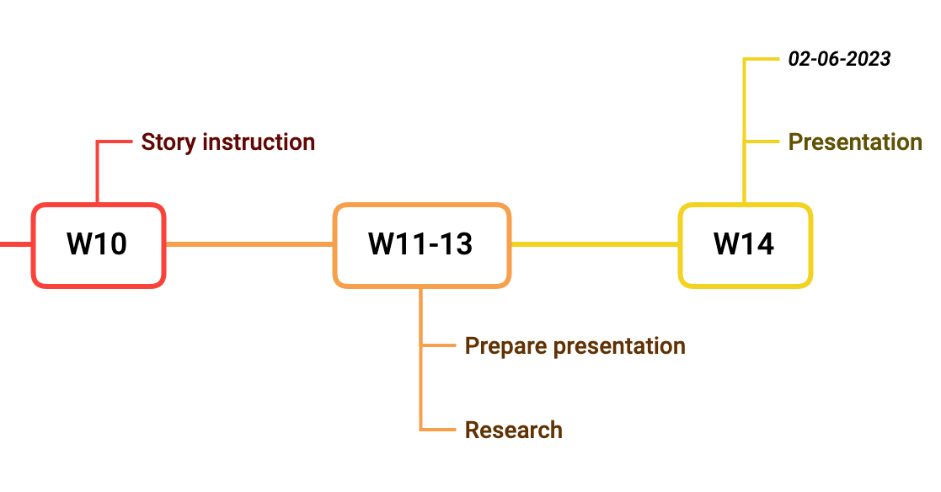
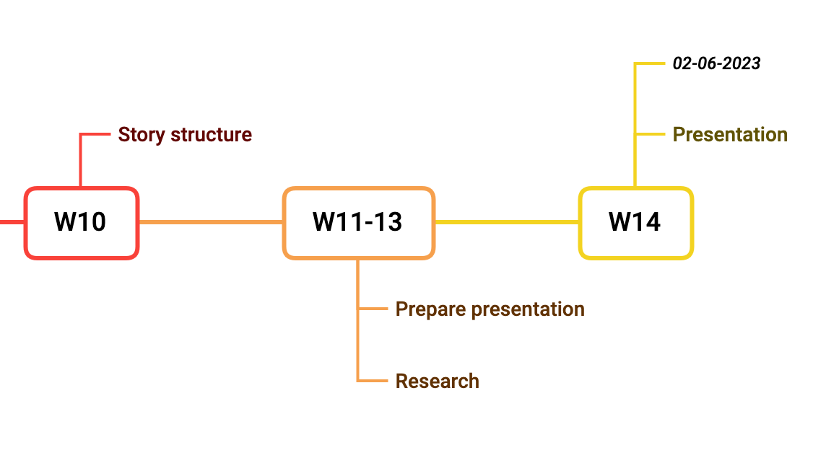
The project timeline

Slide 6
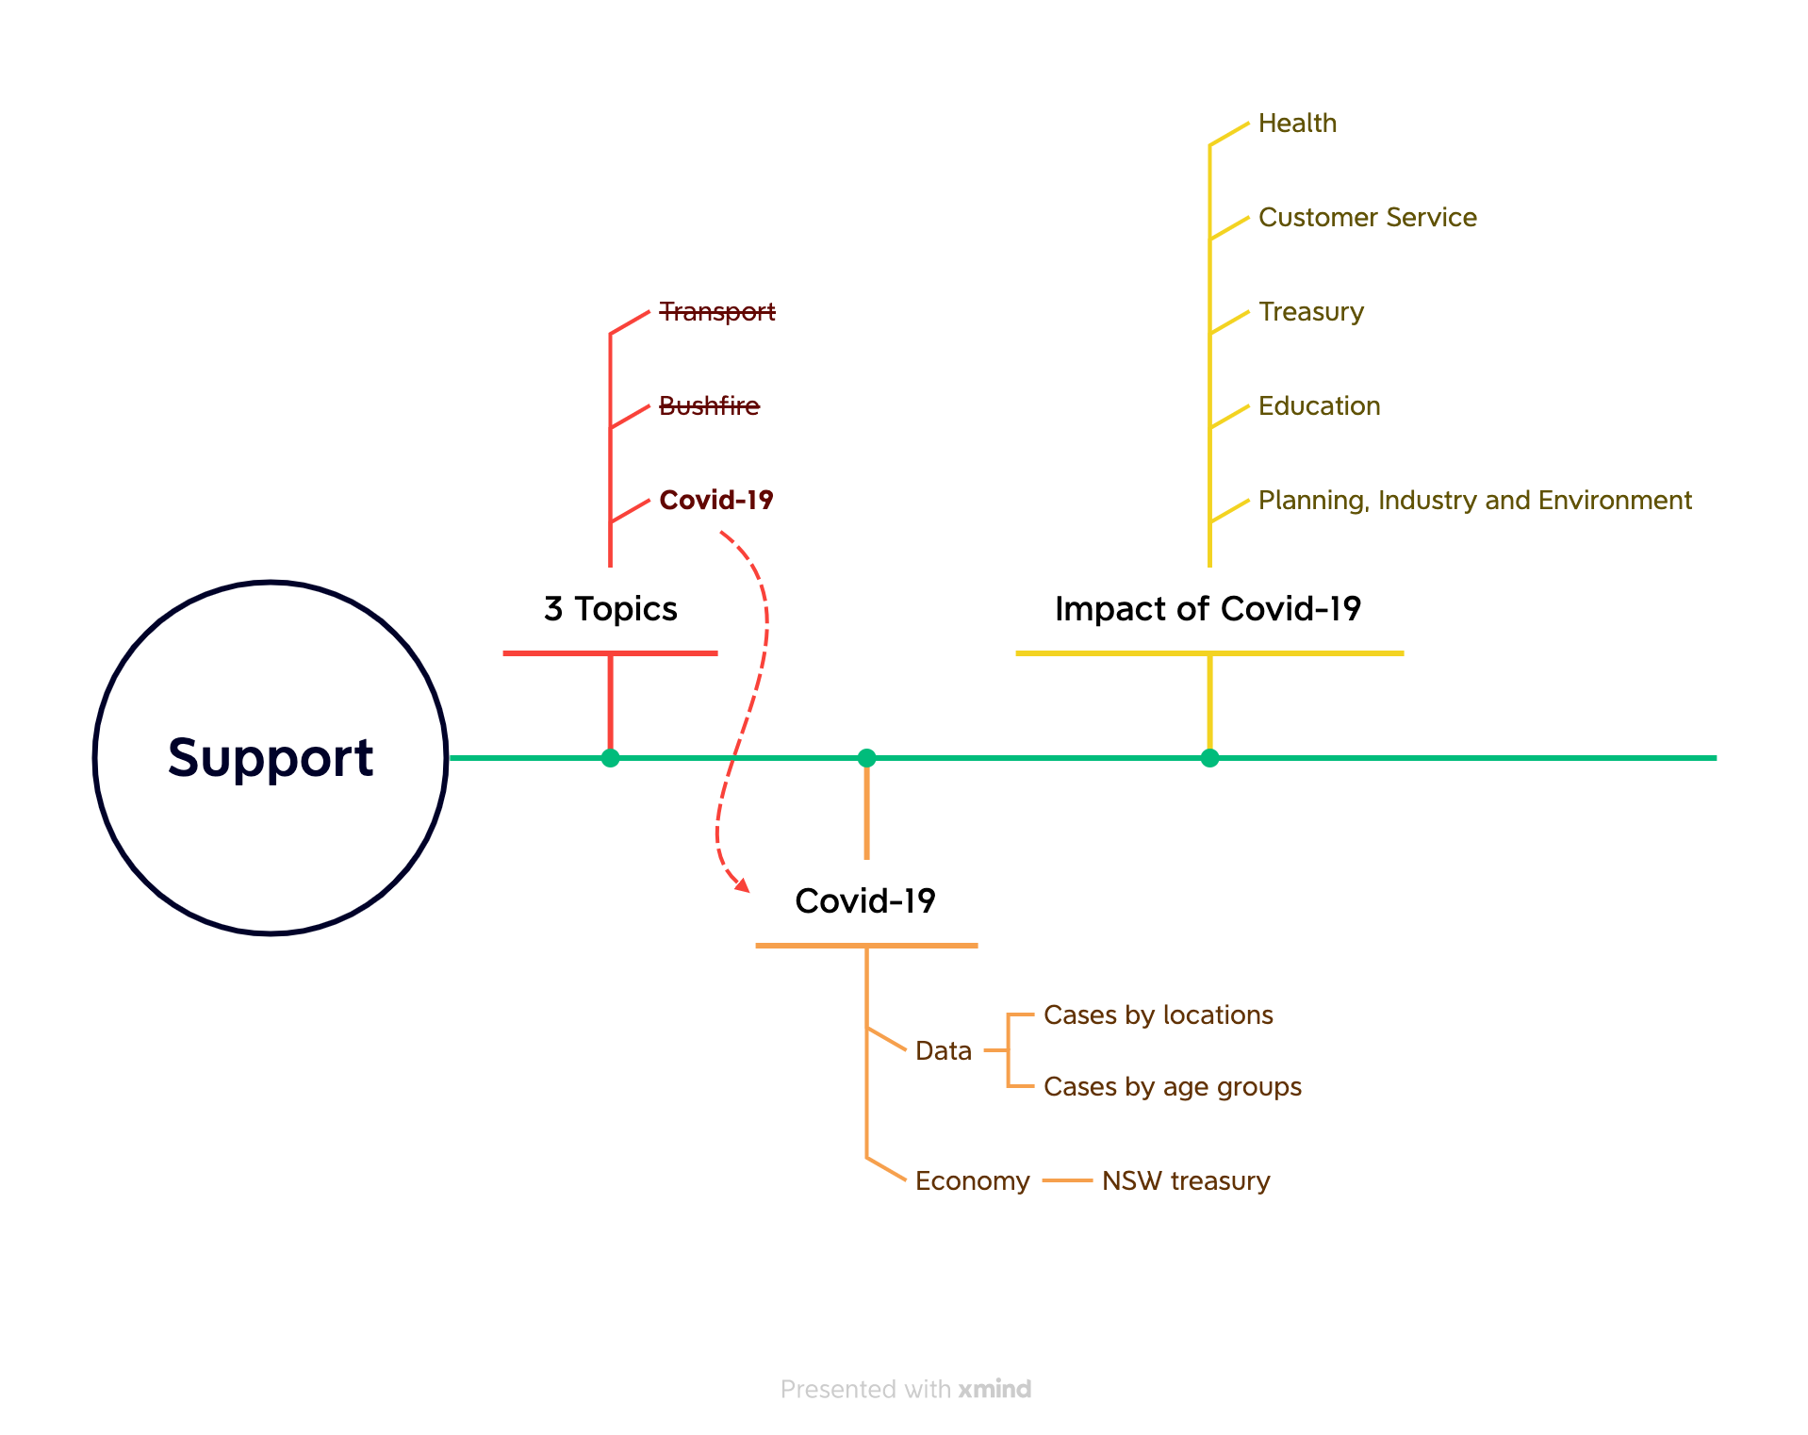
What we did in the first seven weeks

Slide 7
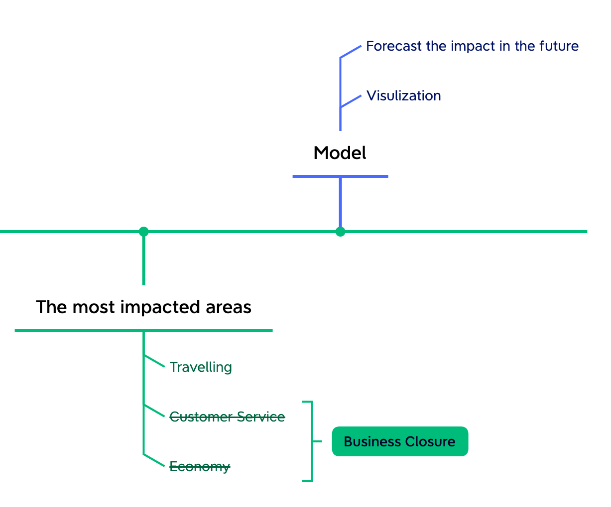
What we did in the first seven weeks

Slide 8
Logical Construction of Tourism Topic
Think about structure of tourism topic (Throughout the project)
Data collection (W8-W9)
Visualization (W9)
Modelling & Modelling improvement (W9 - W12)
Collect tourism support programs (W10 - W11)
Think about tourism support recommendations (W10 - W12)

Slide 9
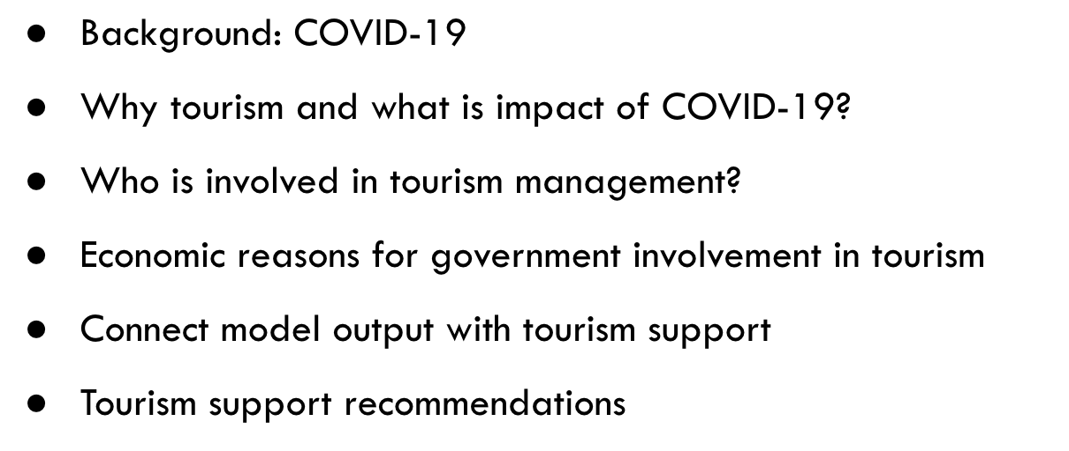
Think about structure of tourism topic (Throughout the project)
Do more researches about tourism
Which part needs data or literatures to support
How to connect tourism and business close

Slide 10
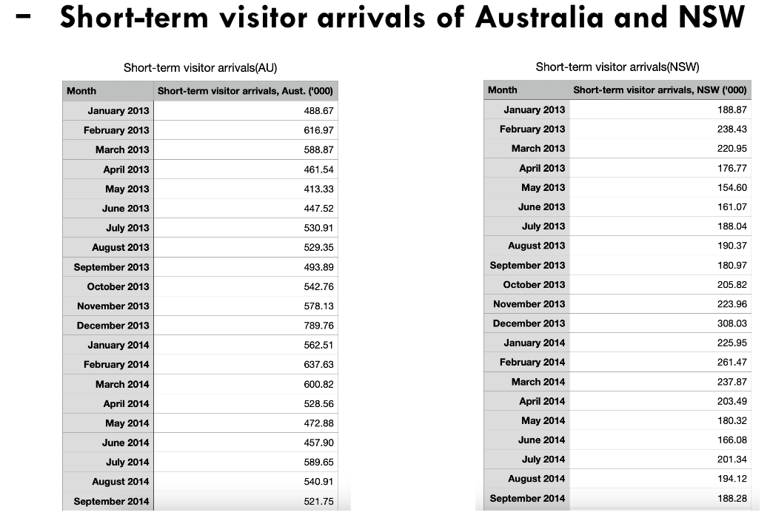
Data collection (W8 - W9)
Collect data from different channels
Lack of detailed periodic data for assessing grant effectiveness🤔🥺😭

Slide 11
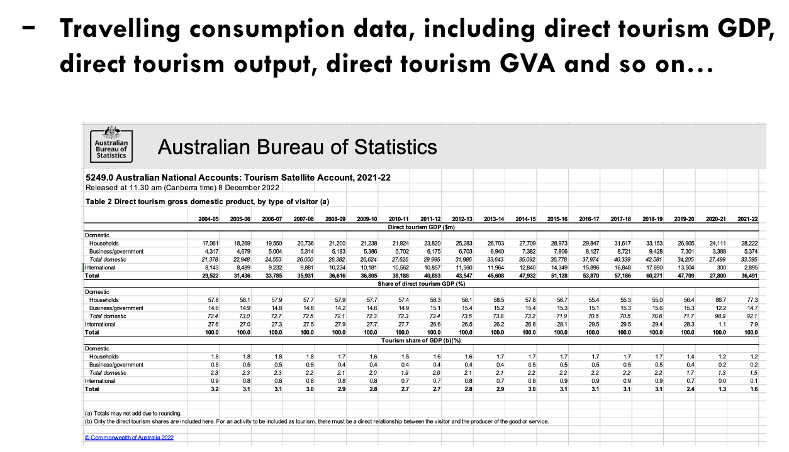
Data collection (W8 - W9)
Collect data from different channels
Lack of detailed periodic data for assessing grant effectiveness🤔🥺😭

Slide 12
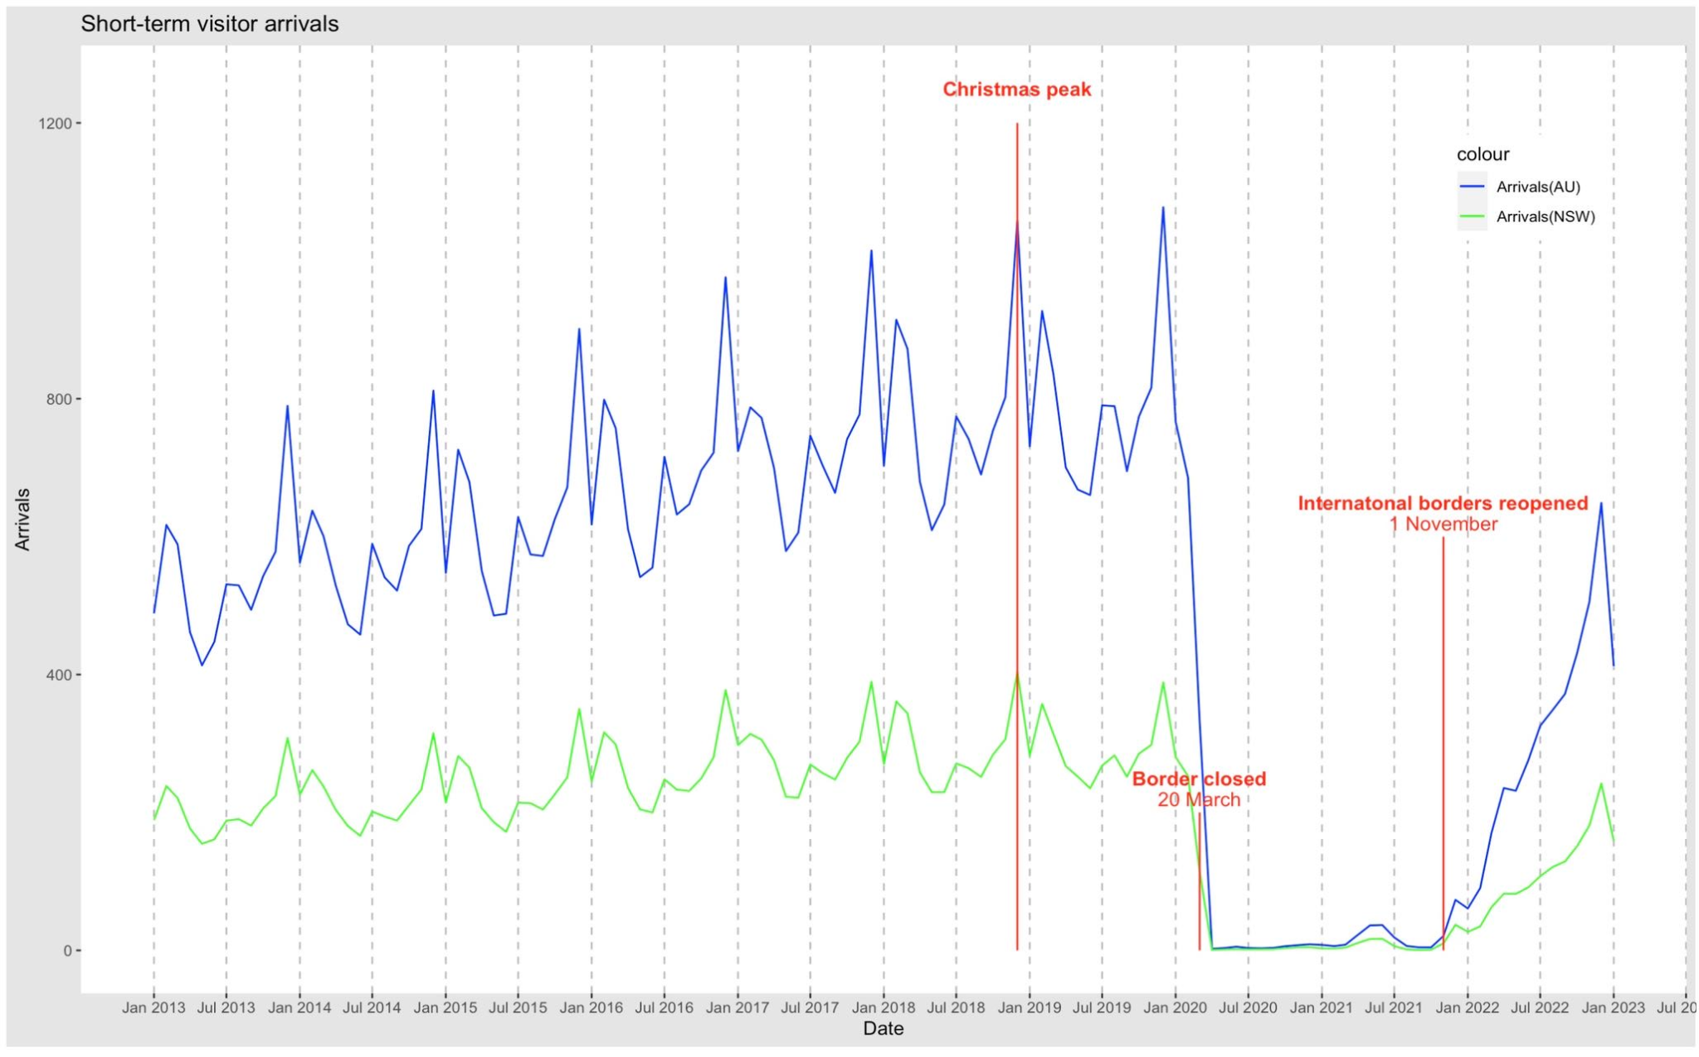
Visualization (W9)
Visualized searched data and observed the overall trend
Verified our assumptions

Slide 13
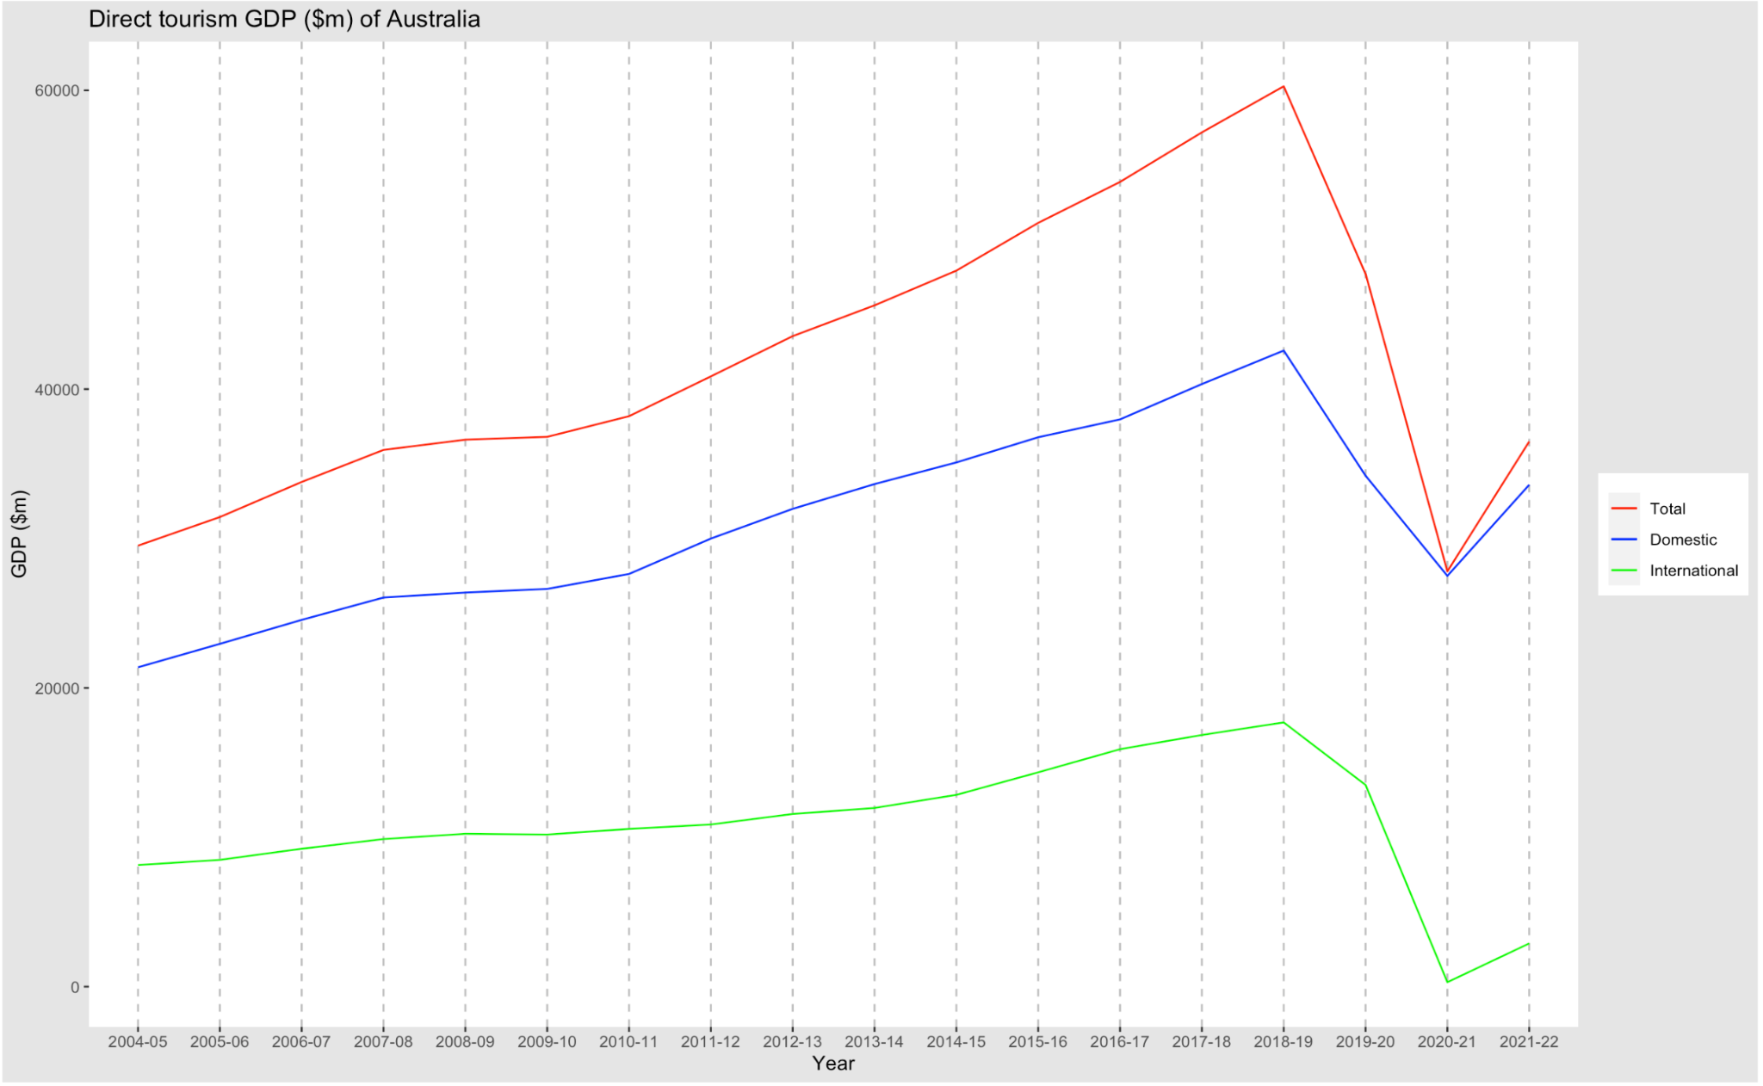
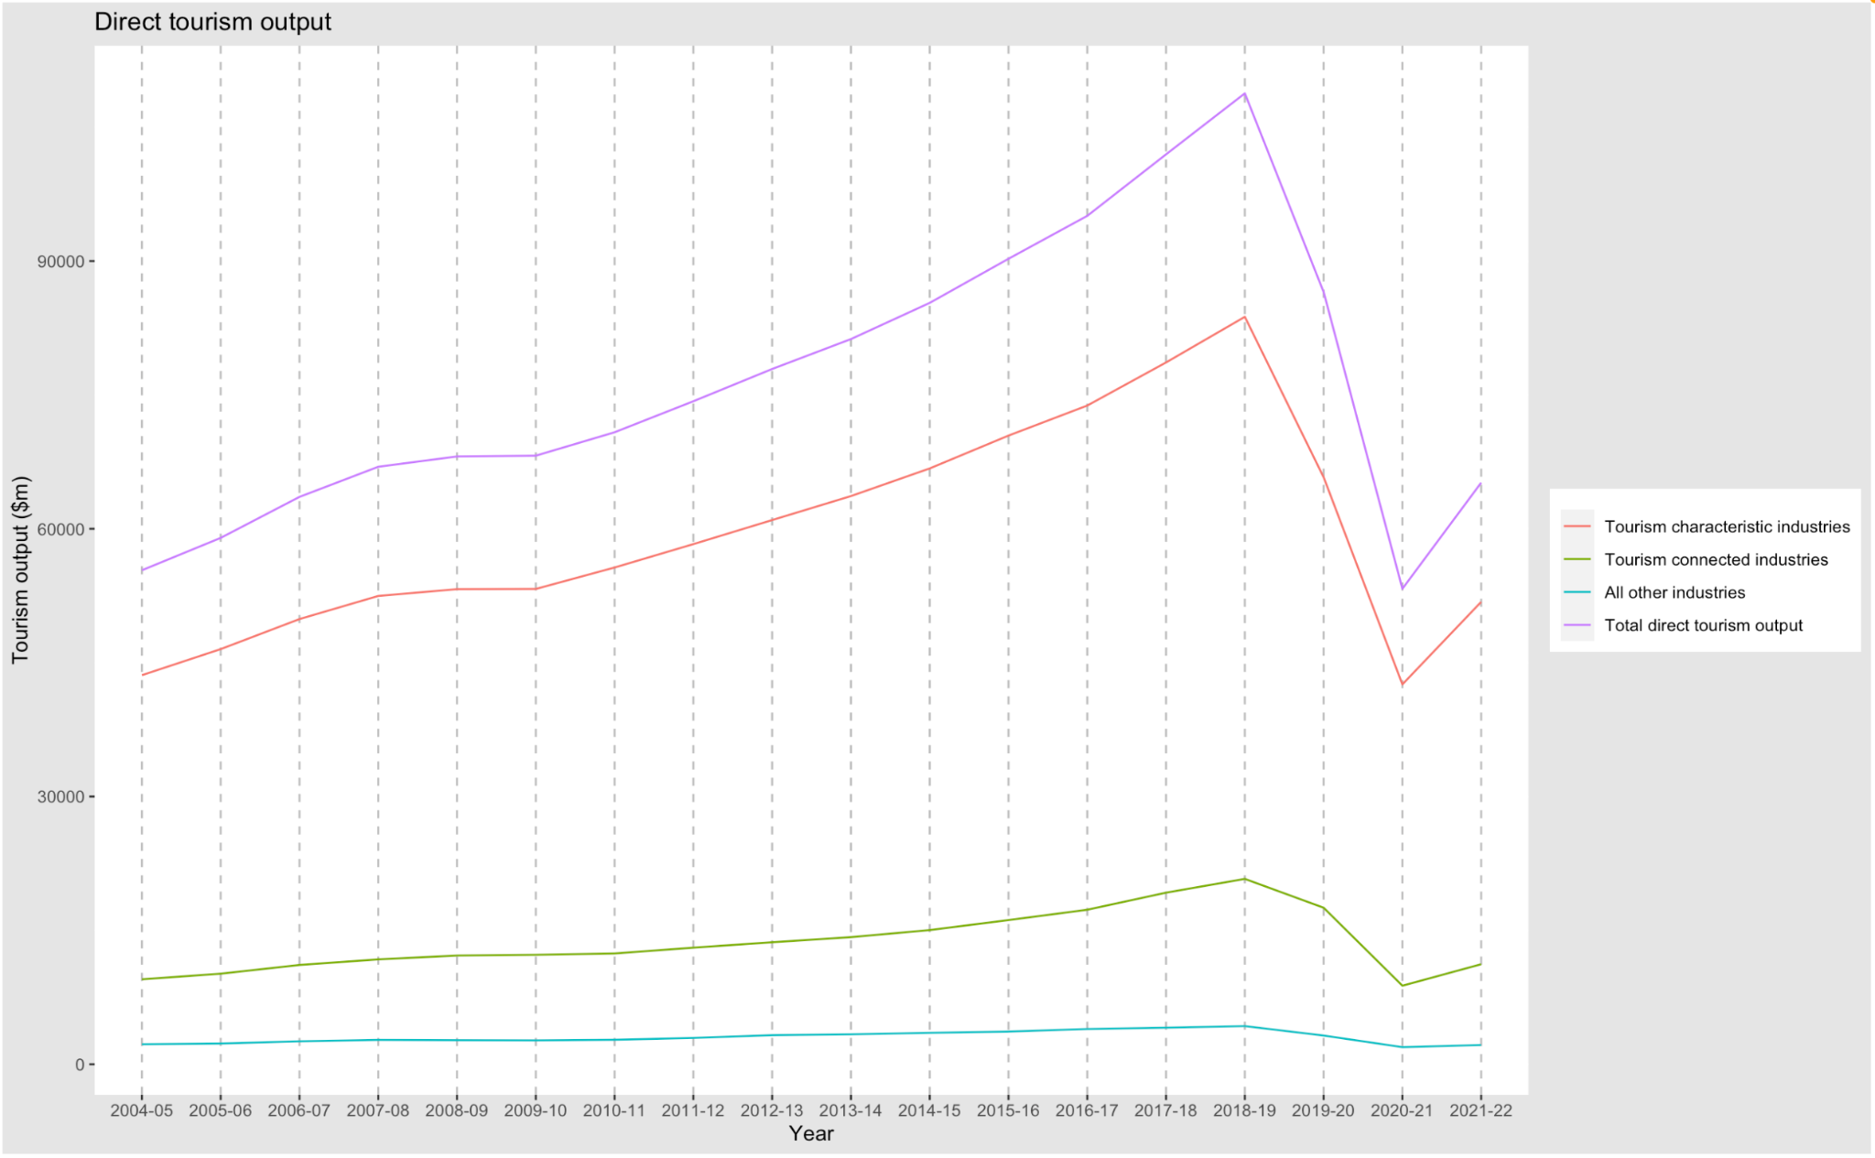
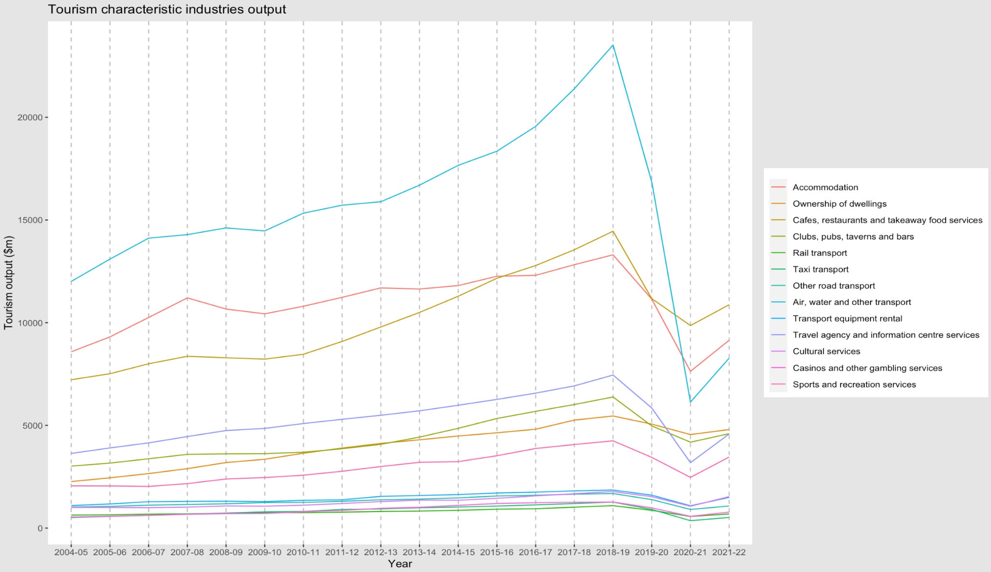
Visualization (W9)

Slide 14
Modelling & Modelling Improvement (W9 - W12)
Focus on impact of similar crisis by modelling
What kind of models are suitable for time series data and have better performance
Autocorrelation verification
Build baseline model (LSTM) and improved model (Transformer)
Improvement

Slide 15
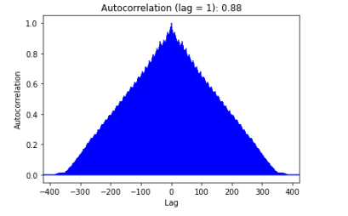
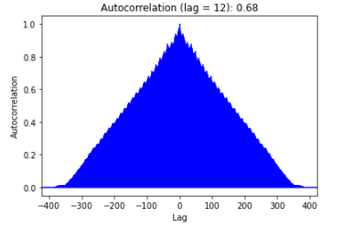
Technical details - Modelling
Before the fitting: Autocorrelation verification

Slide 16
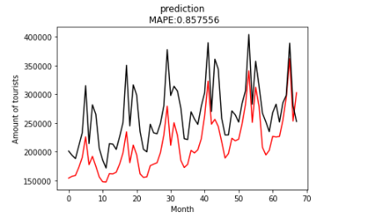
Technical details - Modelling LSTM
Tuning the hyperparameters for evaluation
Hyperparameters
Time steps for the number of months
Hidden units for each layer
Dropout rate
Batch size for each model training
Learning rate for each iteration
Activation for nonlinear transformation

Slide 17
Technical details - Modelling Transformer
Tuning the hyperparameters for evaluation to 91%
Hyperparameters | Best performance para
Time steps | Seq from 1 month to 6 months
channels | 256
Number of heads in the multi-head attention | 8
Number of attention layers | 2
Activation for nonlinear transformation | Relu

Slide 18
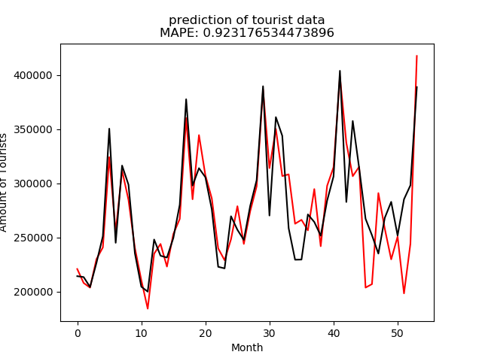
Technical details - Modelling Transformer
Optimize Transformer Model to 92.3%
1.Change one fully connected layer to convolutional layer
2.Change MSE evaluation to MAPE

Slide 19
Collect tourism support programs (W10 - W11)
Search COVID-19 tourism support program releasing by NSW government
Try to find periodic data for assessing grant effectiveness but didn’t release by NSW government

Slide 20
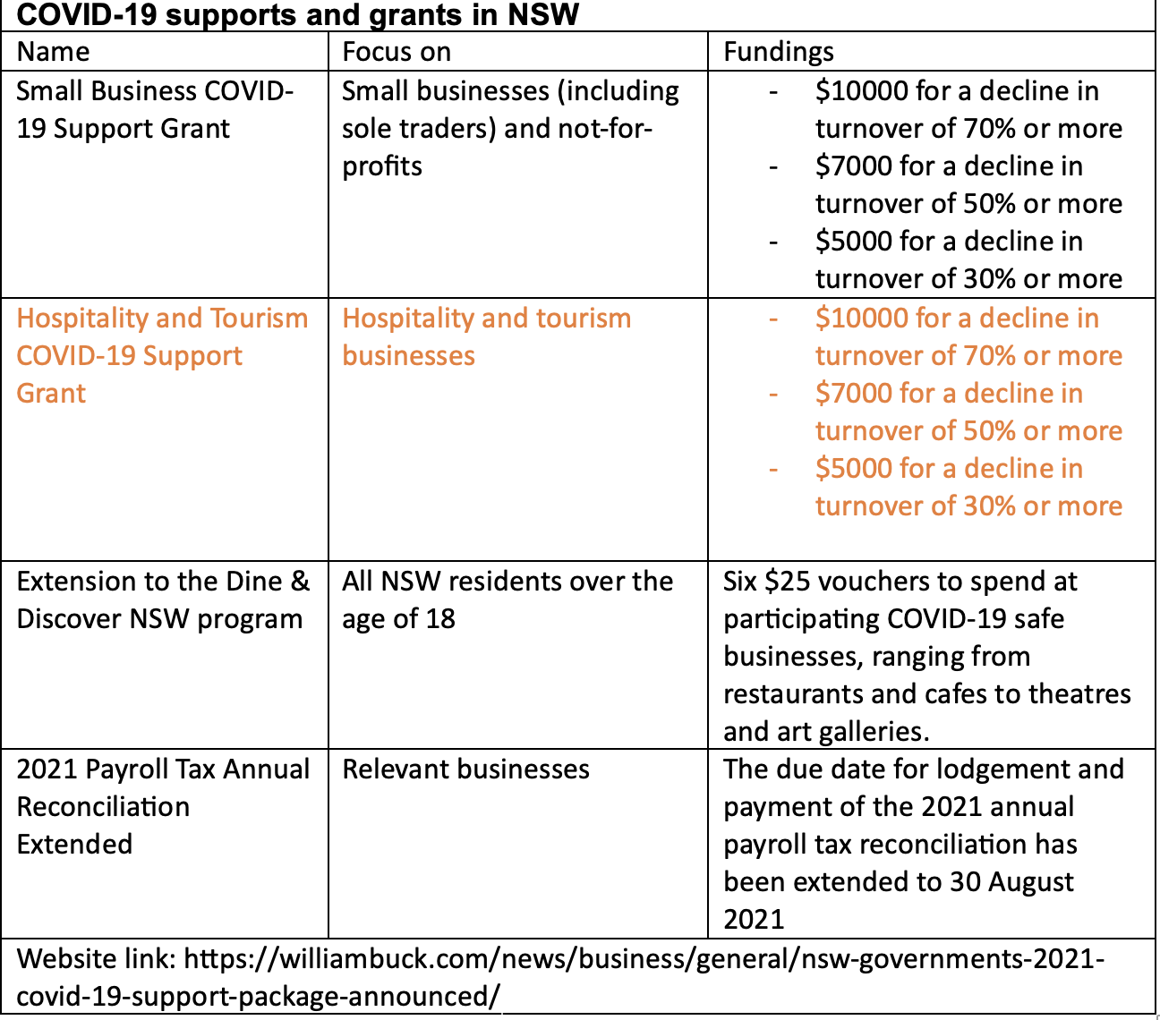
Collect tourism support programs (W10 - W11)

Slide 21
NSW Tourism Support & Grants Recommendations (W10 - W12)
Raised possible support recommendations in four aspects including business, facilities, labour force and tourism investment.
What kinds of support will be needed in different stages such as recovery stage and pre-crisis stage.
How to verify support recommendations and how to test these hypotheses.
Obstacle: Assumed we have got the access of such detailed periodic measure data, we can provide train of thoughts. The content tends to be more comprehensive.

Slide 22
Business close support measurement-W7-W11
What have been done and why
Conclusion

Slide 23
Business close support measurement-W7
What have been done and why
Review COVID-19 business grants support

Slide 24

Business close support measurement-W7
What have been done and why
Review COVID-19 business grants support
Extract time range and support eligibility metrics
• Time range
• Support eligibility metrics - Turnover range
• Support eligibility metrics- Highly impacted industries

Slide 25
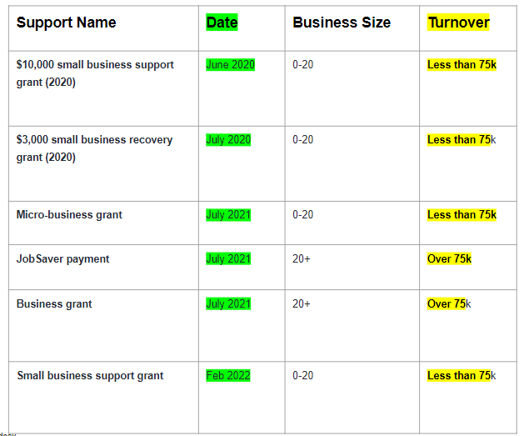
Business close support measurement-W7
2. Extract time range and support eligibility metrics
• Time range
• Turnover range
• Highly impact industries

Slide 26
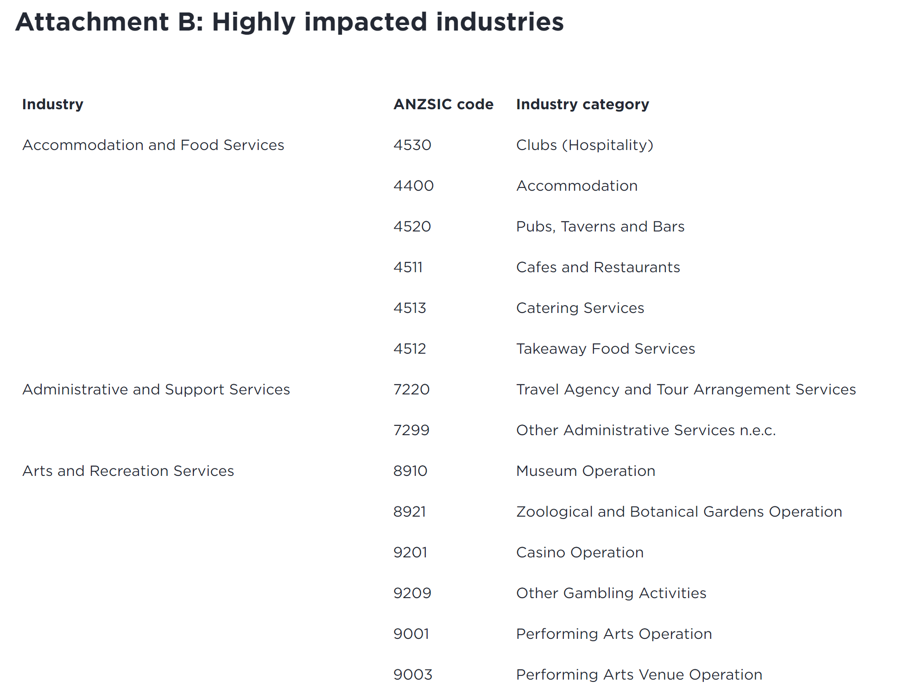
Business close support measurement-W7
2. Extract time range and support eligibility metrics
• Time range
• Turnover range by specific time
• Highly impact industries

Slide 27
Business close support measurement-W7
What have been done and why
Review COVID-19 business grants support
Extract time range and support eligibility metrics
Match the metrics extracted to the data collected

Slide 28
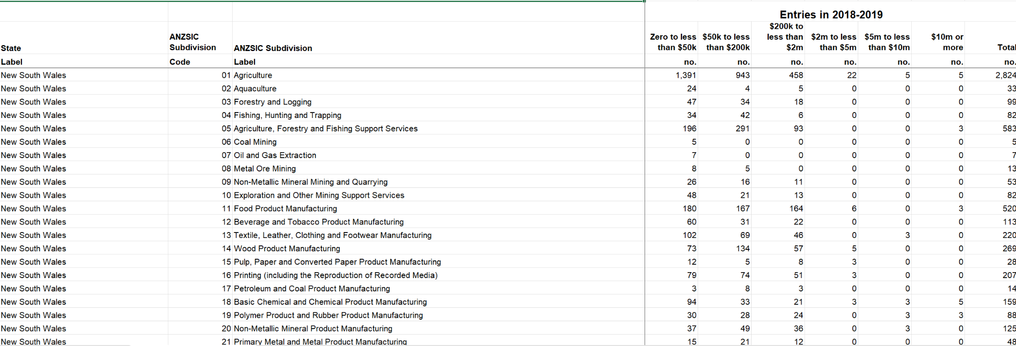
Business close support measurement-W7
3. Match the metrics extracted to the data collected
Turnover range
Highly Impacted Industries

Slide 29
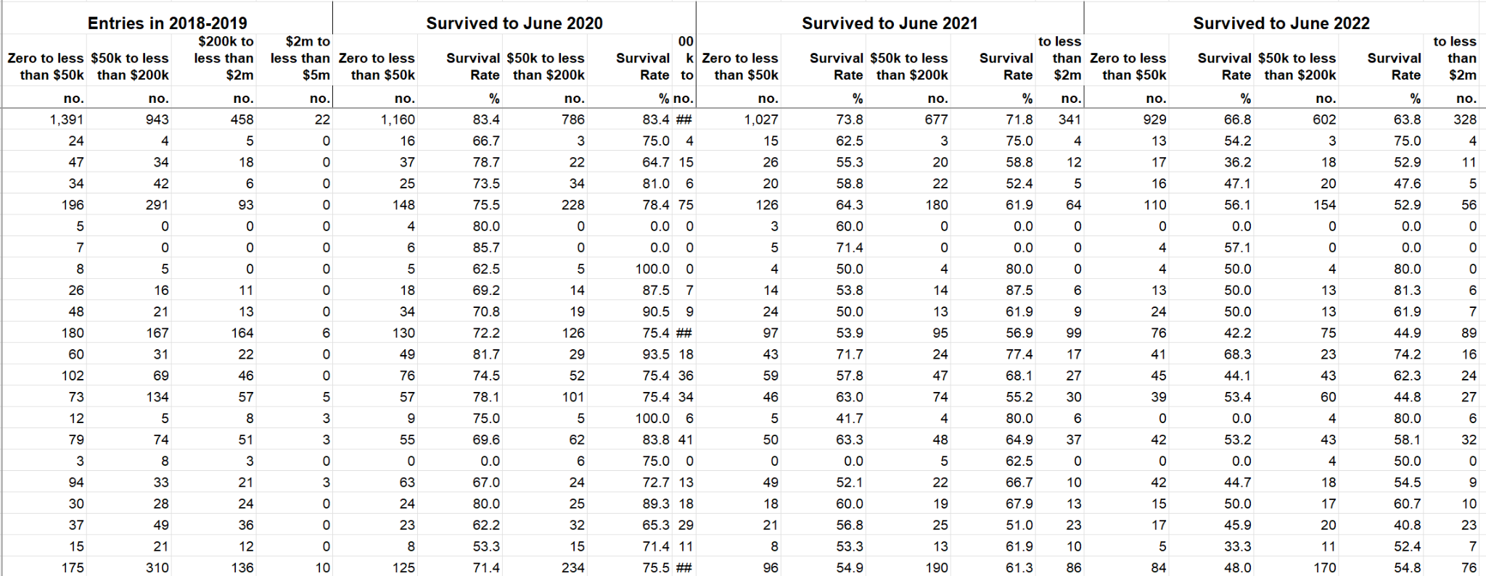
Business close support measurement-W7
3. Match the metrics extracted to the data collected
Time range

Slide 30
Business close support measurement-W7
What have been done and why
Review COVID-19 business grants support
Extract time range and support eligibility metrics
Match the metrics extracted to the data collected
• Time range- Which grant are received (2020, 2021, 2022)
• Turnover range- Small businesses or big businesses
• Highly impact industries- Businesses more likely to receive grants

Slide 31
Business close support measurement-W7
What have been done and why
Review COVID-19 business grants support
Extract time range and support eligibility metrics
Match the metrics extracted to the data collected
A forecast model to measure the support success
Forecast result as the baseline (before the grants received)
Current data (after the grants received)

Slide 32
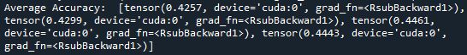
Business close support measurement-W7
Poor prediction performance
Only have 2018-2022 annually data (5 time slots), Time series forecasting need at least 25 time slots (25 years or 25 months)

Slide 33

Business close support measurement-W7
Conclusion
Review COVID-19 business grants support
Extract time range and support eligibility metrics
Match the metrics extracted to the data collected
Match the real business grants with the data collected so that we could use the data to measure the success of the business grants
A forecast model to measure the support success
Using Tableau visualizations/ dashboards and Python-based automated visualizations to for the support success measurement instead of using forecast model.

Slide 34
Business close support measurement-W8
What have been done and why
Tableau initial visualizations
Data exploration for better understanding
Investigate interesting insights:
Number of businesses close trend vary by years and industries

Slide 35
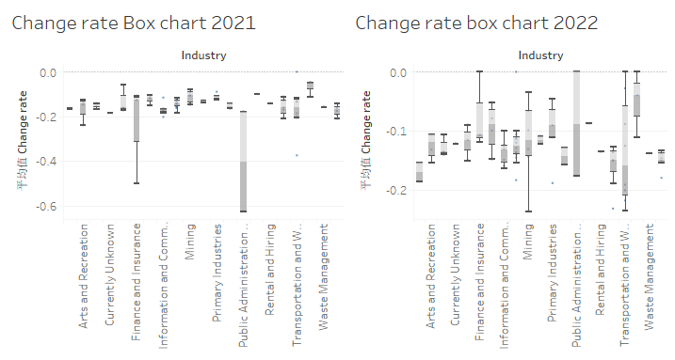
Business close support measurement-W8
What have been done and why
Tableau initial visualizations

Slide 36
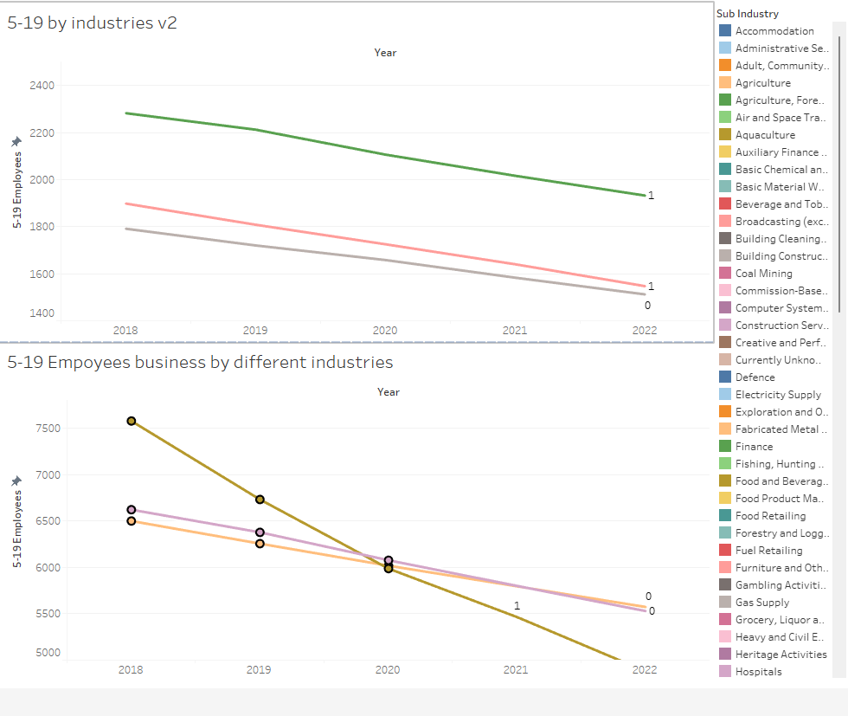
Business close support measurement-W8
What have been done and why
Tableau initial visualizations

Slide 37
Business close support measurement-W8
What have been done and why
Tableau initial visualizations
Number of businesses close trend vary by years and industries
Python-based automated visualizations
Automated generated visualizations to show the support success
Axis design needs improvement (improved in W10)

Slide 38
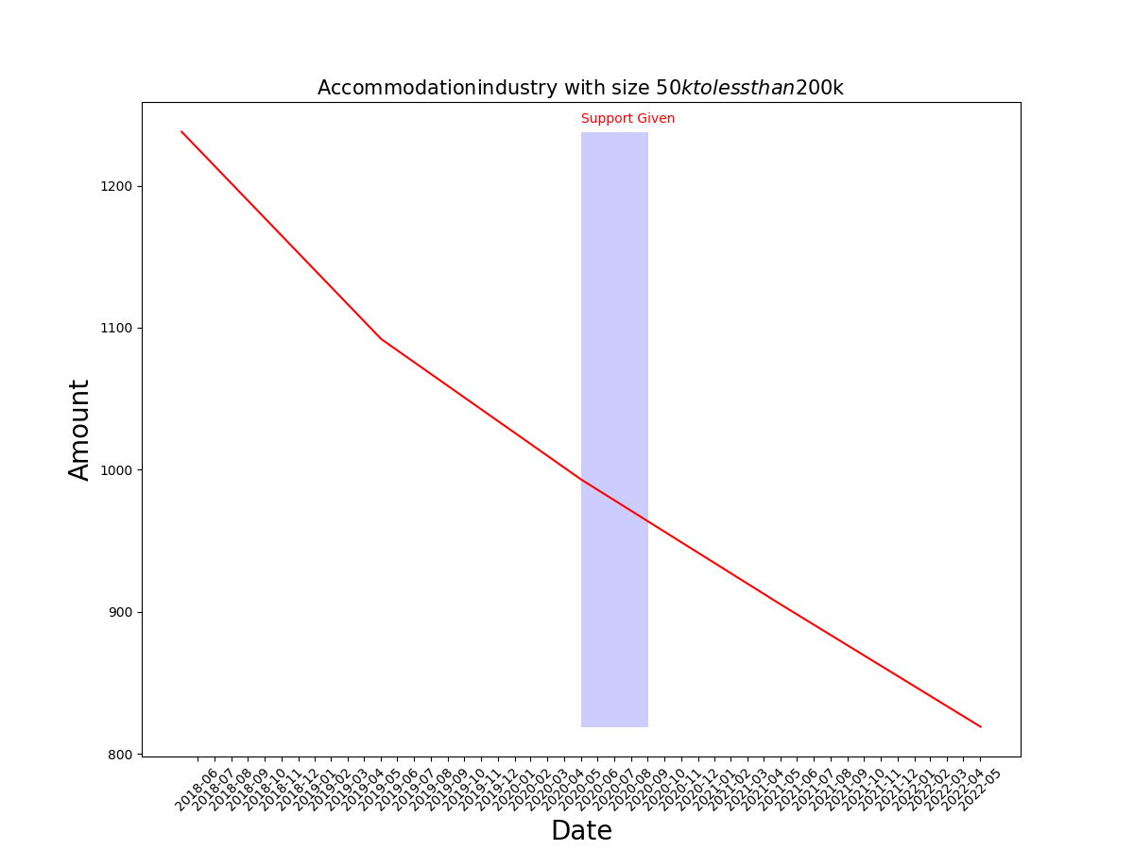
Python-based automated visualizations- W8

Slide 39
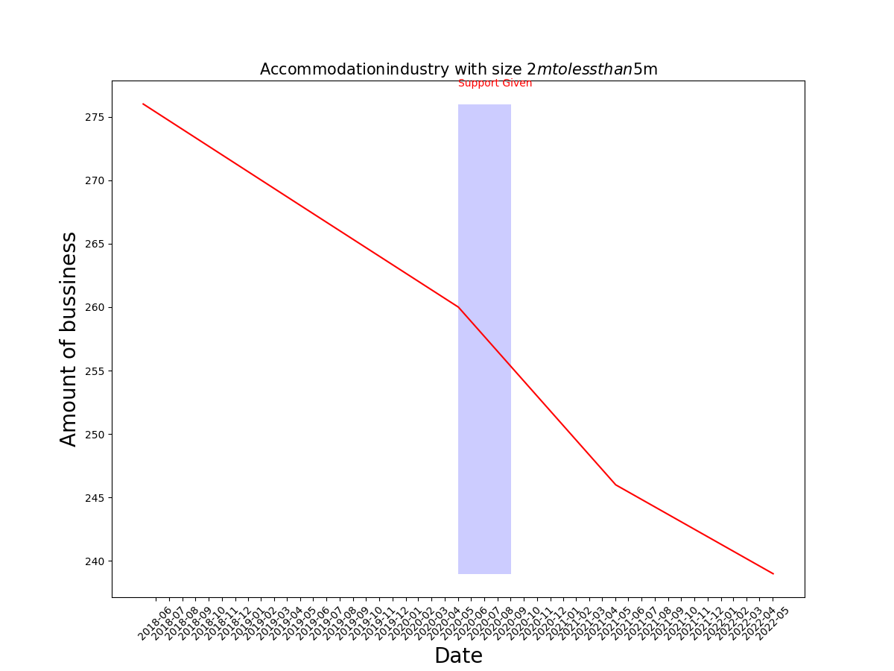
Python-based automated visualizations- W10

Slide 40
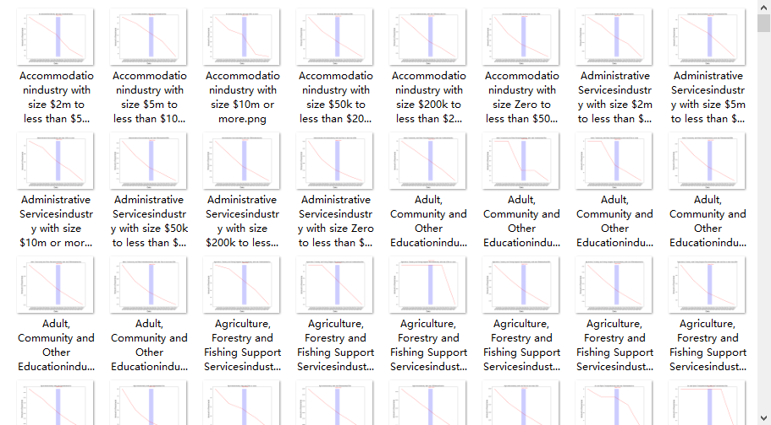
Business closes Python automated visualizations

Slide 41
Business close support measurement-W8
Conclusion
Tableau initial visualizations
Number of businesses close trend vary by years and industries
Python-based automated visualizations
Automated generated visualizations to show the support success
Axis design needs improvement (improved in W10)

Slide 42
Business close support measurement-W9
What have been done and why
Improved Tableau visualizations/ dashboards
Created the calculated field ‘business close rate deceleration’ to show the decrease of the business close rate year by year
Business close rate deceleration as support success measurement criteria
Measure the success of small business grants to specific industries in 2020, 2021

Slide 43
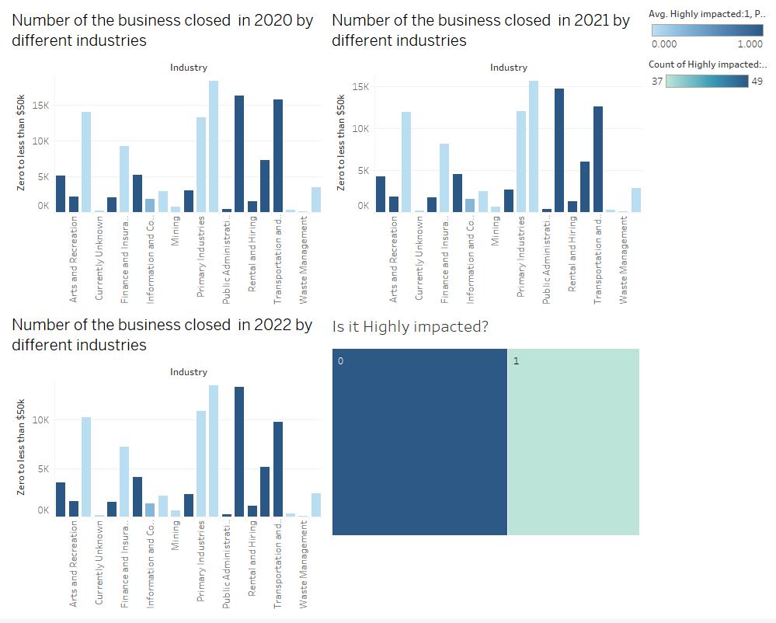
Business close support measurement-W9
W8 initial visualizations W9 tableau dashboards

Slide 44
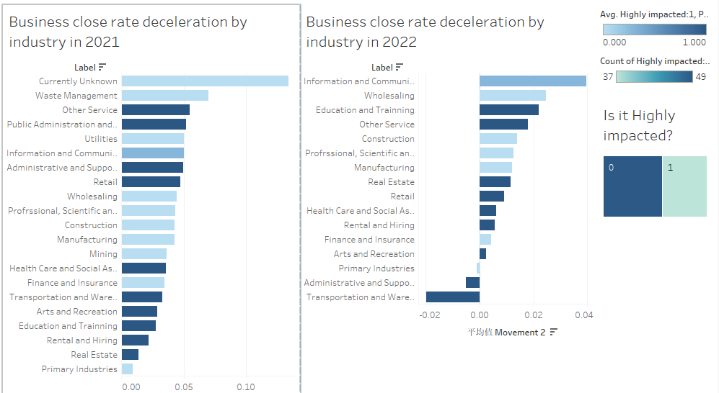
Business close support measurement-W9
W8 initial visualizations W9 tableau dashboards

Slide 45
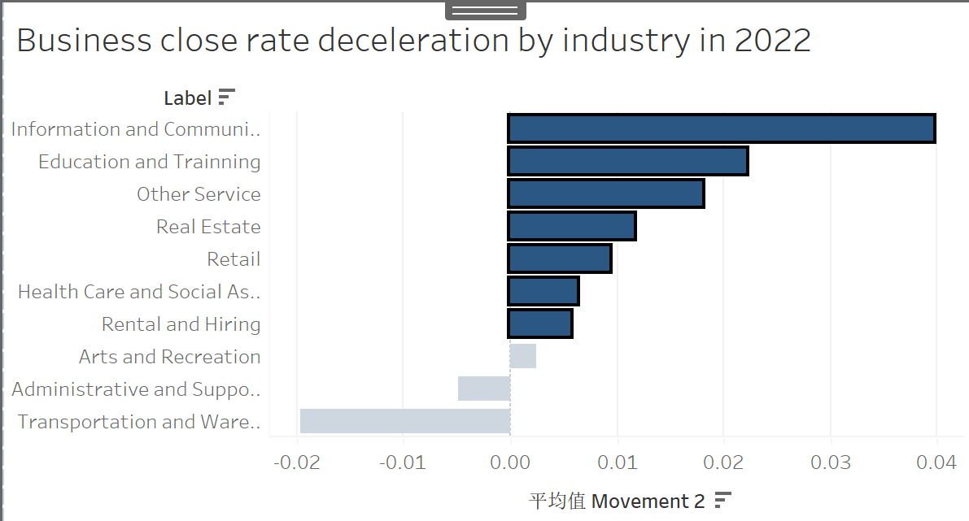
Business close support measurement-W9
Measure the success of the support to the small businesses-in 2020,2021 by specific industries
Success Measurement Criteria: Business close rate deceleration
Conclusion: The small business grants is successful/ unsuccessful to specific industries’ small businesses in 2020,2021.
Recommendation:
COVID-19 micro-business grant (2021)
Small business support grant (2022)

Slide 46

Business close support measurement-W9
Measure the success of the support to the small businesses-in 2020,2021 by specific industries
Success Measurement Criteria: Business close rate deceleration
Conclusion: The small business grants is successful/ unsuccessful to specific industries’ small businesses in 2020,2021.
Recommendation:
COVID-19 micro-business grant (2021)
Small business support grant (2022)

Slide 47
Business close support measurement-W9
Conclusion
Improved Tableau visualizations/ dashboards
The small business grants is successful/ unsuccessful to specific industries’ small businesses in 2020,2021.

Slide 48
Business close support measurement-W10
What have been done and why
Initial summary for the overall progress of the business close support measurement

Slide 49
Business close support measurement-W10
What have been done and why
Initial summary for the overall progress of the business close support measurement

Slide 50
Business close support measurement-W10
Background: Covid-19
Methods to measure the impact of the support
A transition matrix-based neural network — lack of complete time series
Improved support success measurement visualizations/ dashboards
Python Automated Visualization
The Expected outcomes we could provided
Areas where support will be most needed
Provide recommendation of business support

Slide 51
Business close support measurement-W10
What have been done and why
Initial summary for the overall progress of the business close support measurement
Axis and other design improvement on the Python-based automated visualizations generation

Slide 52
Business close support measurement-W10
Conclusion
Initial progress summary for the business support success measurement
Progress summary needs to be more detailed to show the progress and conclusions
Improved Python-based automated visualizations
Axis and other design improvement

Slide 53
Business close support measurement-W11
What have been done and why
Detailed progress summary for business close support measurement
Prepare for the final report

Slide 54
Business close support measurement-W7
Conclusion
Review COVID-19 business grants support
Extract time range and support eligibility metrics
Match the metrics extracted to the data collected
Match the real business grants with the data collected so that we could use the data to measure the success of the business grants
A forecast model to measure the support success
Using Tableau visualizations/ dashboards and Python-based automated visualizations to for the support success measurement instead of using forecast model.

Slide 55
Business close support measurement-W8
Conclusion
Tableau initial visualizations
Number of businesses close trend vary by years and industries
Python-based automated visualizations
Automated generated visualizations to show the support success
Axis design needs improvement (improved in W10)

Slide 56
Business close support measurement-W9
Conclusion
Improved Tableau visualizations/ dashboards
The small business grants is successful/ unsuccessful to specific industries’ small businesses in 2020,2021.

Slide 57
Business close support measurement-W10
Conclusion
Initial progress summary for the business support success measurement
Progress summary needs to be more detailed to show the progress and conclusions
Improved Python-based automated visualizations
Axis and other design improvement

Slide 58
Business close support measurement-W11
Conclusion
Detailed progress summary for business close support measurement
Prepare for the final report

Slide 59
Business close support measurement
Limitations and future work

Slide 60

Thank you !!!

